Slide 1
Bazele inteligenței artificiale
Laborator – Grigore Ionuț

Slide 2
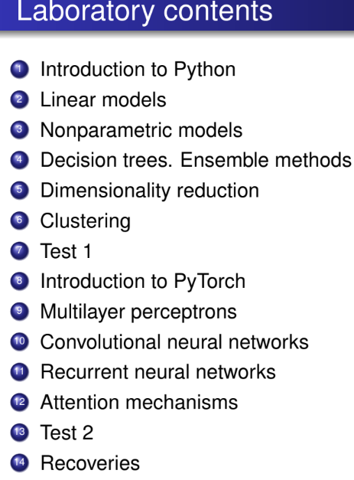

today’s lab

Slide 3
Content
k-Nearest neighbors
Linear SVM classification
Nonlinear SVM classification
SVM regression

Slide 4
1) k-Nearest neighbors

Slide 5
Classification

Slide 6
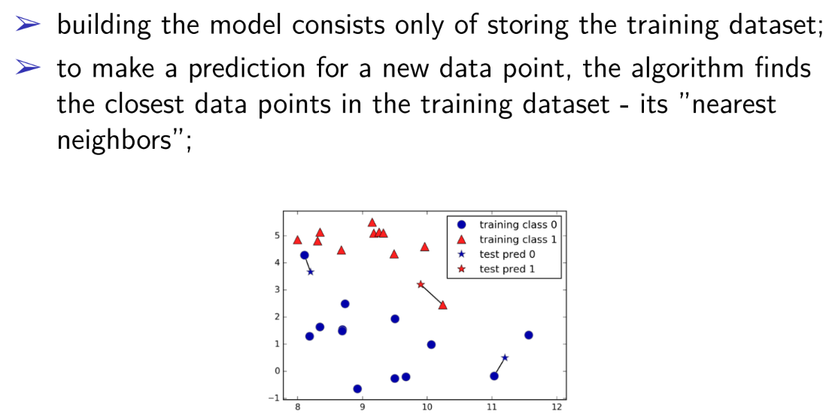

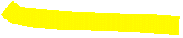
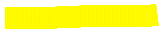
Nonparametric! We don’t have parameters w!

Slide 7
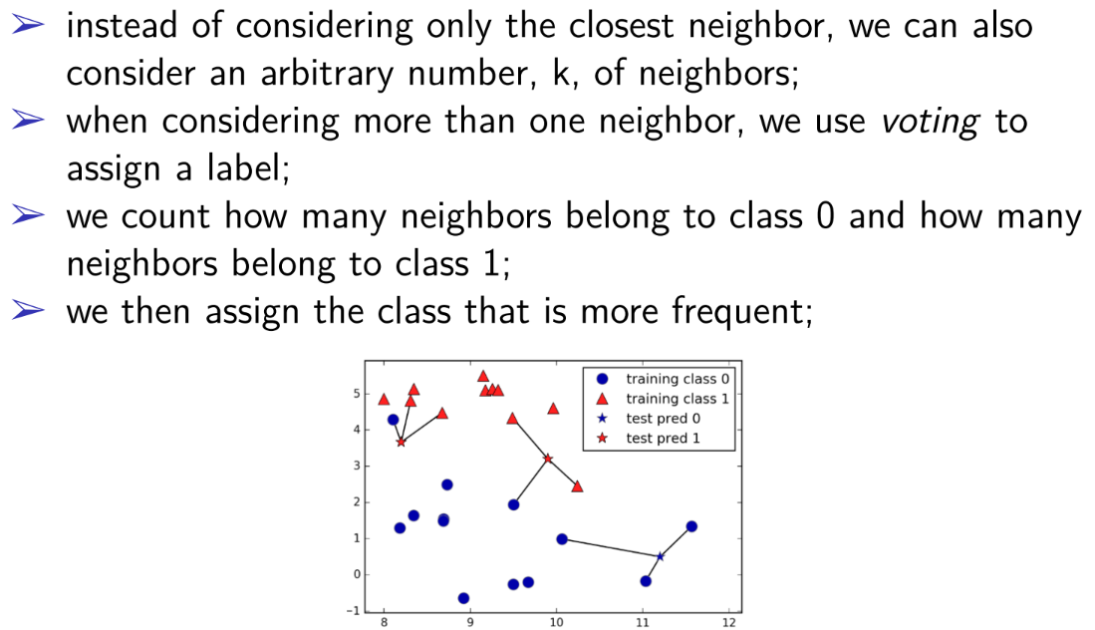

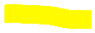
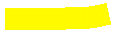

Slide 8

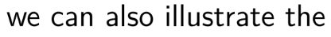
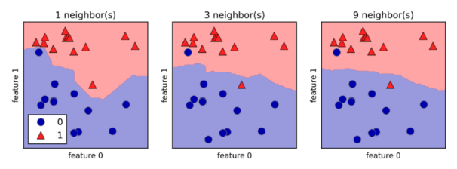

Slide 9
Regression

Slide 10
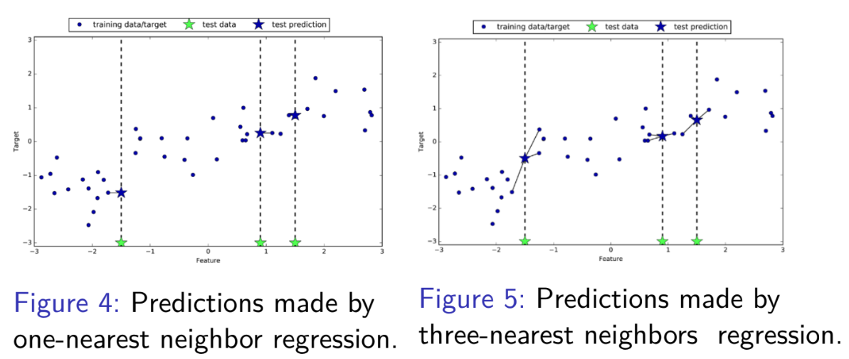
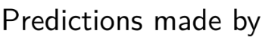
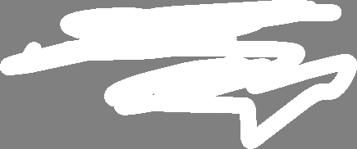
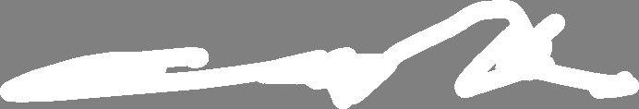
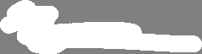
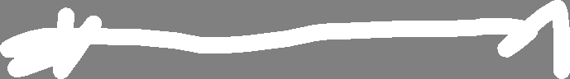
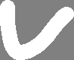
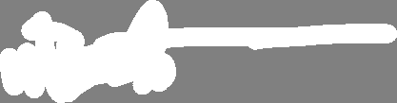
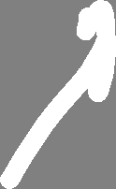
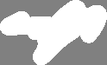
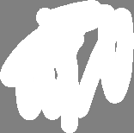
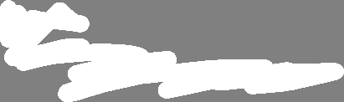
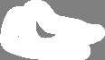
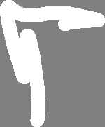
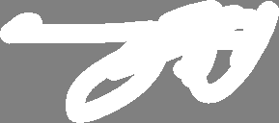
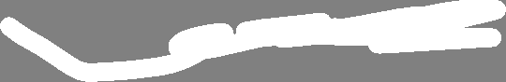
For each green star, it looks for the nearest blue dot, and whatever the value of that blue dot is (from OY axis), it becomes the prediction (blue star). It's like asking your closest friend for advice and following exactly what they say.
For each green star, it looks at the three closest blue dots, takes their values (from OY axis), and averages them to come up with a prediction (blue star). This way, you're getting a more balanced opinion because you're asking a few more people.

Slide 11
2 important things are essential for k-Nearest neighbors:
the number of neighbors
how we measure the distance between data points (Euclidean distance is commonly used)

Slide 12


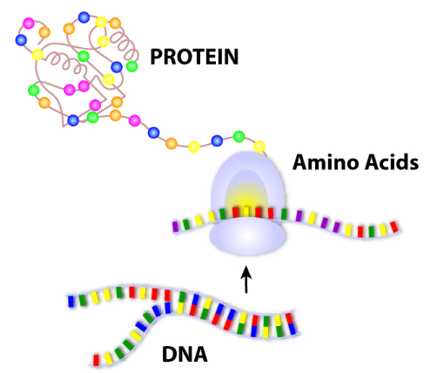
Real-World Uses of k-Nearest Neighbors (k-NN)
Where k-NN is used (some examples):
Healthcare: Predicting disease based on patient similarity (e.g., diabetes, heart disease).
Recommendation systems: “Users who liked this also liked…” (product or movie similarity).
Bioinformatics: Classifying genes or protein sequences by similarity.

Slide 13
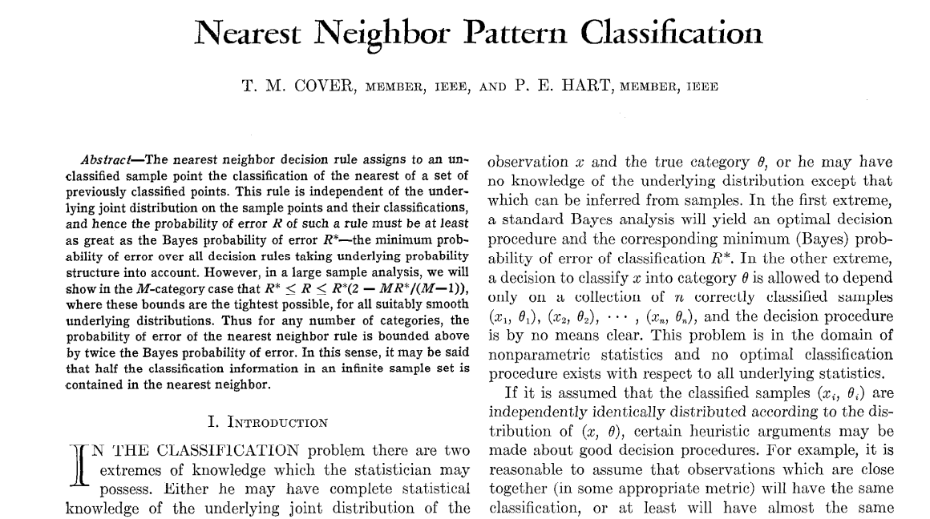
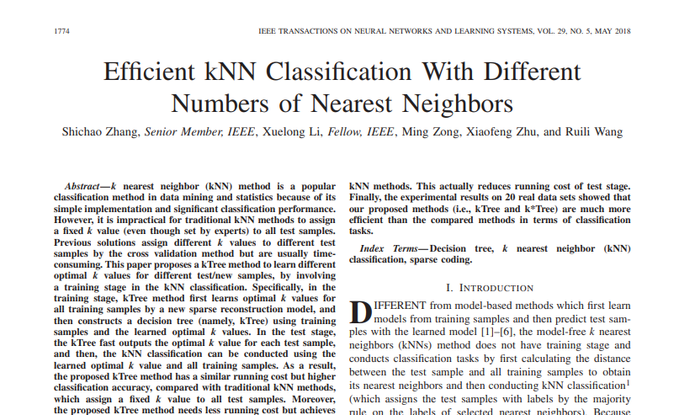
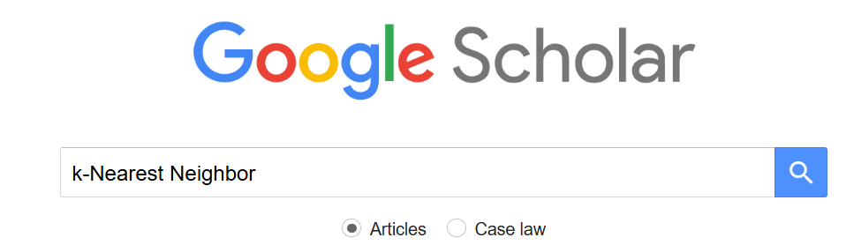
Notable papers
Cover & Hart (1967) — Nearest neighbor pattern classification → foundational work.
Zhang (2017) — Efficient kNN classification with different numbers of nearest neighbors
and many other examples…find more here on Google Scholar:

Slide 14
Code part

Slide 15
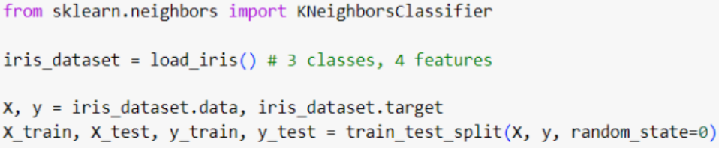
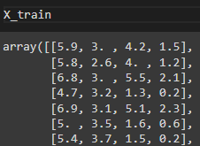
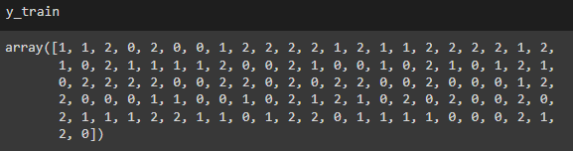

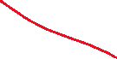


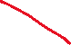
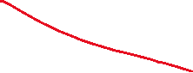
3 classes of flowers:
setosa (0)
versicolor (1)
virginica (2)
sepal length
sepal width
petal length
petal width

Slide 16
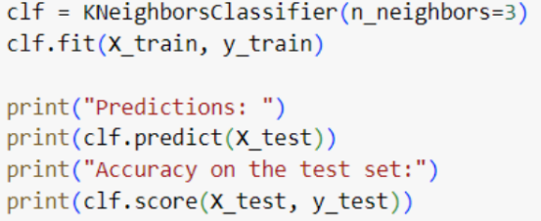
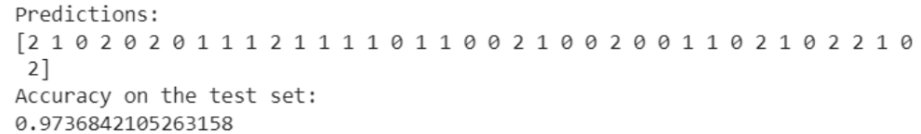
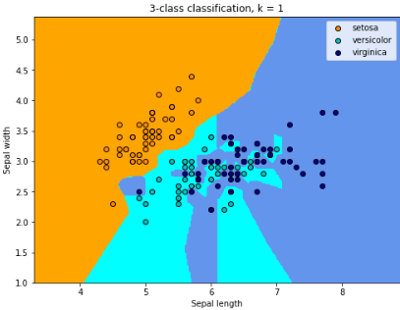
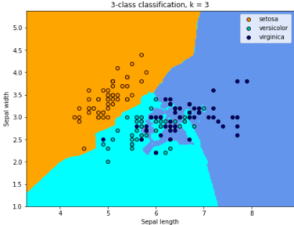
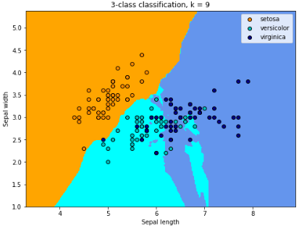
here we applied KNeighborsClassifier just for the first 2 features! (because we cannot plot figures in 4D ☺)

Slide 17
2) Linear SVM classification

Slide 18
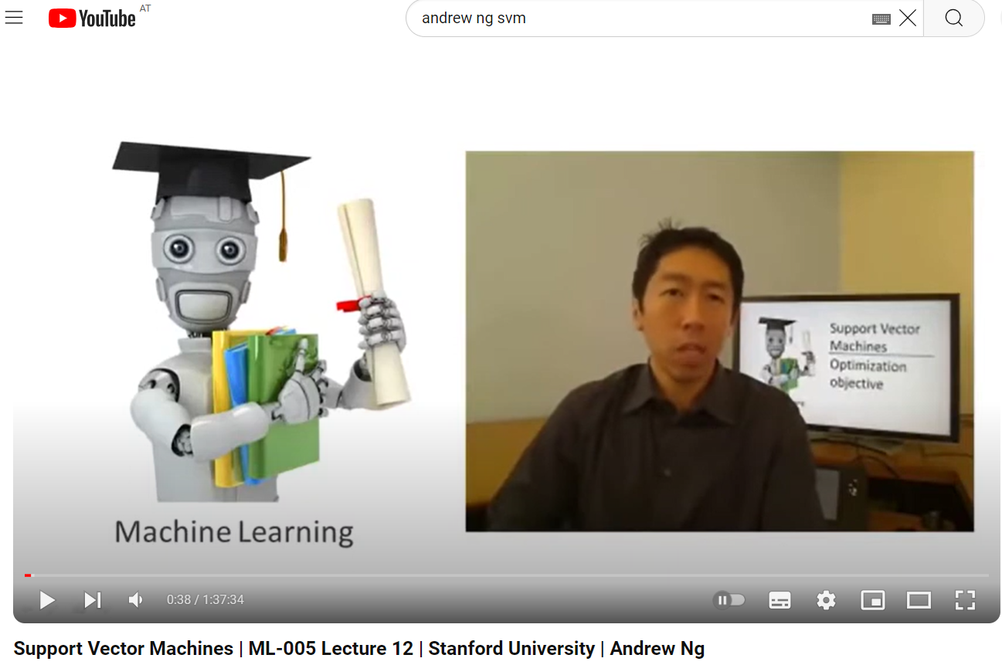
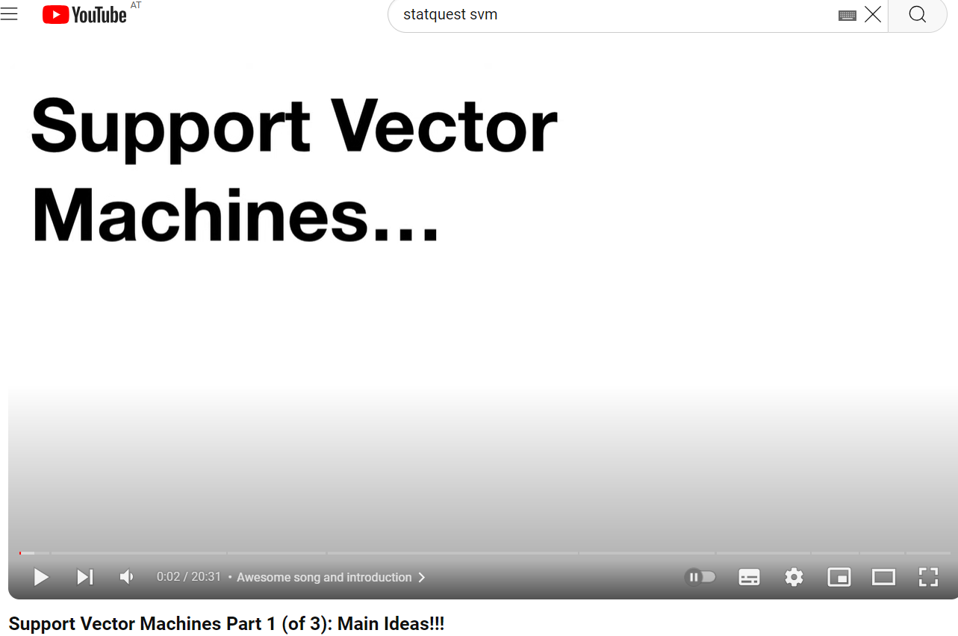

Slide 19
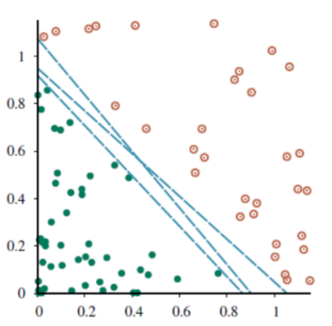

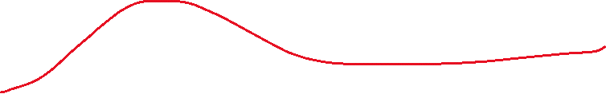
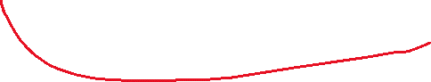
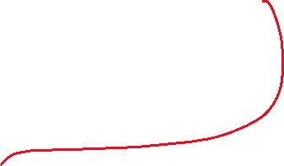
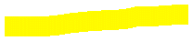
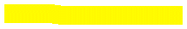
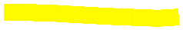
We have the following dataset which is called linearly separable (the green points can be separated from the red points by a line)
In the figure we have 3 possible linear separators (the blue lines)
As we see, there can be infinitely many such linear separators (such lines)
How do we know which one is best to choose?
We can shift the line a tiny bit up and down without coming into contact with any of examples

Slide 20
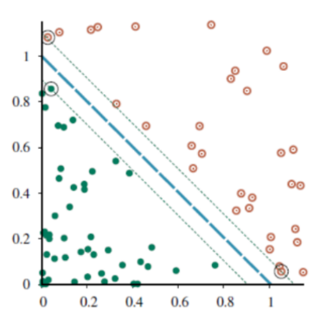







To find a unique solution, we need to choose the line that maximizes the margin between the green and red circles
Basically we want the blue line to be as far away from the closest training examples as possible (and obviously to separate the points ☺ )
This line is called maximum margin separator
The points with large circles are called support vectors
margin

Slide 21







But what if the green and red points cannot be separated by a line (like in the left plot) ?
In this case we want to find a line that doesn’t perfectly separate the green and red points we can misclassify a few points but better classifying the remaining ones
can be separated by a line – hard margin SVM
When the points
cannot be separated by a line – soft margin SVM

Slide 22
TL;DR — Intuiția din spatele SVM
Marginea (margin): Este spațiul liber dintre cele două clase — zona care separă punctele verzi de cele roșii. Cu cât marginea e mai mare, cu atât modelul e mai sigur și generalizează mai bine.
Support vectors: Sunt punctele aflate cel mai aproape de linia de separare. Ele “țin” linia în poziție — dacă le miști, linia se schimbă! (De aici și numele: “vectors that support the margin”).
Scopul SVM: Găsește linia (sau planul) care separă clasele și are cea mai mare margine posibilă, chiar dacă permite câteva clasificări greșite.

Slide 23
Optional – explaining the math behind

Slide 24



In general, a hyperplane is defined by the following equation:

Slide 25








NOTE 1
NOTE 2

Slide 26


NOTE 1
NOTE 2

Slide 27




Slide 28








Slide 29




The hyperplane that separates the 2 classes is defined by:
w^{T}x+a = 0
w^{T}x+w₀ = 0
w^{T}x+b = 0
Then, the 2 parallel hyperplanes that define the margin (purple and green line) are:
Let’s assume we have the following dataset:
w^{T}x+a = 0
w^{T}x+b = 0
w^{T}x+w₀ = 0
margin

Slide 30









Without allowing any misclassifications in the hard margin SVM, we want to maximize the distance between the two hyperplanes.
To find this distance, we can use the formula for the distance of a point from a plane So the distance of the blue points and the red point from the black line would respectively be:
.
a
b
2
2
As a result, the total margin would become:
a
b
2
We want to maximize this margin. Without the loss of generality, we can consider a = w₀-1 and b = w₀+1. Subsequently, the problem would be to maximize or minimize
2.
2
2

Slide 31








To make the problem easier when taking the gradients, we’ll instead work with its squared form:
w₀
2
This optimization comes with some constraints. Let’s assume that the labels for our classes are {-1, +1} (the red stars are +1 and blue stars are -1).
When classifying the data points, we want the points belonging to positives classes to be greater than +1 and the points belonging to the negative classes to be less than -1, meaning:
w^{T}x+a 0 ⬄ w^{T}x+w₀-1 0 ⬄ w^{T}x+w₀ 1
w^{T}x+b 0 ⬄ w^{T}x+w₀+1 0 ⬄ w^{T}x+w₀ -1

Slide 32

In a similar way as Hard Margin SVM Optimization but more numbers and Greek notations, for more info see the following link:
https://www.baeldung.com/cs/svm-hard-margin-vs-soft-margin

Slide 33





Real-World Uses of Support Vector Machines (SVM)
Where SVM is used (some examples):
Medical diagnosis: Classifying tumors (benign vs. malignant), disease detection from MRI or gene data.
Computer vision: Object / face recognition, handwriting classification (MNIST dataset).
Fraud detection: Detect unusual transaction patterns indicating fraud.

Slide 34



Notable papers
Cortes & Vapnik (1995) — Support-vector networks → the original SVM paper.
Guyon et al. (2002)— Gene selection for cancer classification using support vector machines
and many other examples…find more here on Google Scholar:

Slide 35
Code part

Slide 36


Let’s build an SVM classifier to distinguish between the setosa and versicolor types in the iris dataset, based only on the petal length and petal width features:

Slide 37






1) Hard margin SVM
for hard margin C is set to +
it means that we want a perfect separation of the data without allowing any misclassifications
this means the decision boundary is a linear hyperplane
( a line, a plane, etc.) ☺
function for plot already done in lab

Slide 38





1) Soft margin SVM
is used in SVM to calculate the error for misclassified points:
if the point is correctly classified, the loss is 0
if the point is misclassified, the loss is proportional to how far the point is from being correctly classified
a small value of C makes the SVM more tolerant of misclassifications and margin violations. The model will allow more points to be within the margin or even on the wrong side of the hyperplane
a larger C value forces the SVM to be stricter
function for plot already done in lab

Slide 39
3) Nonlinear SVM classification

Slide 40

What happens if we have nonlinear datasets like in the left plot?
SOLUTION: add more features (e.g polynomial features) such that to create a linearly separable dataset in higher dimensions

Slide 41







Nonlinearly separable
Linearly separable
NOTE: when we say linearly or nonlinearly we are not necessarily referring to a line, we refer to something that is linear (the equation of a plane in 3D is also linear)
The generalization of a 2D line or a 3D plane in called hyperplane

Slide 42
Code part

Slide 43


our dataset

Slide 44





function for plot already done in lab
You don’t need to worry about them, You will have these parameters for test ☺

Slide 45








….or alternatively using the kernel trick…
don’t worry about them
don’t worry about them
function for plot already done in lab
function for plot already done in lab

Slide 46


…or using more sophisticated kernels…

Slide 47


What is kernel trick?

Slide 48
4) SVM regression

Slide 49




Slide 50


Slide 51


Slide 52
TL;DR — Intuiția din spatele SVM Regression (SVR)
În clasificare, SVM caută linia care separă cel mai bine două clase, lăsând un spațiu liber (margine) între ele.
În regresie, nu mai vrem să separăm clase, ci să desenăm o linie care urmează cât mai bine trendul datelor.
În jurul acestei linii, SVR creează o zonă-tub (ε):
→ punctele din interiorul tubului sunt considerate „predicții bune”,
→ iar cele din afară sunt erori (modelul nu le poate explica perfect).
Epsilon (ε) controlează cât de „larg” e acest tub:
ε mare: modelul e mai tolerant, trece „printre” date fără să le urmeze prea exact.
ε mic: modelul devine mai strict, încearcă să treacă aproape prin fiecare punct.

Slide 53
Code part

Slide 54






function for plot already done in lab
You don’t need to worry about them, you will have these parameters for test ☺

Slide 55






function for plot already done in lab
You don’t need to worry about them, you will have these parameters for test ☺

Slide 56

k-Nearest Neighbors (k-NN): Looks at the closest data points and predicts based on their values:
Classification: Chooses the most common label among neighbors.
Regression: Averages their numeric values to make a prediction.
Linear SVM (Classification): Finds the best straight line (or plane) that separates classes with the largest margin between them.
Nonlinear SVM (Classification): Uses the kernel trick to bend the space, allowing separation when data isn’t linearly separable.
SVM Regression (Linear & Nonlinear): Tries to fit a line or curve that stays as close as possible to all points, but ignores small errors within a tolerance range (the “ε-tube”).

Slide 57
Exercises

Slide 58


Slide 59




Solutions

Slide 60




k=1
k=5
k=9

Slide 61
…or if we introduce a bit noise in data….

Slide 62



Slide 63



k=1
k=5
k=9

Slide 64



Slide 65



Slide 66



Slide 67



Slide 68


Slide 69


Slide 70
Thank you !

